Slide 1
Autoencoders
Date:28.10.2022

Slide 2
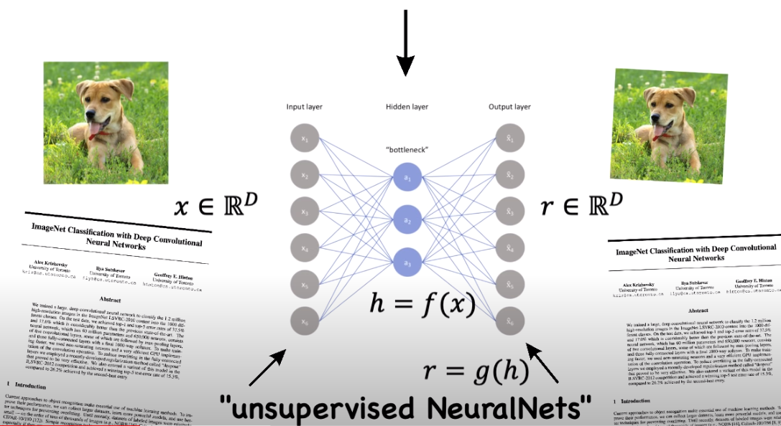
Autoencoders in a nutshell

Slide 3
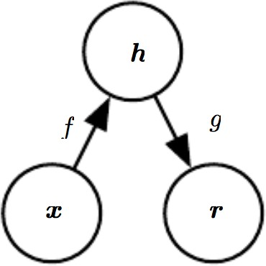
Autoencoders
An autoencoder is a feed forward unsupervised neural network that is trained to attempt to copy its input to its output.
In other word,Maps an input x to an output r (called reconstruction) through an internal representation code h
The network may be viewed as consisting of two parts:
An encoder function h=f(x)
A decoder that produces a reconstruction r= g(h)

Slide 4
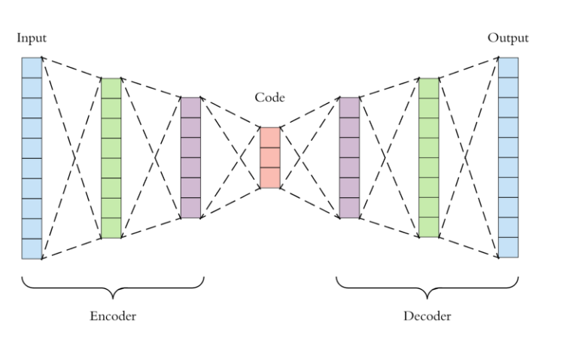
For single layer Encoder and Decoder:
input_l=Input(shape=(784,))
bottleneck=Dense(32, activation='relu')(input_l)
output_l=Dense(784, activation='sigmoid')(bottleneck)

Slide 5
Different Types!

Slide 6
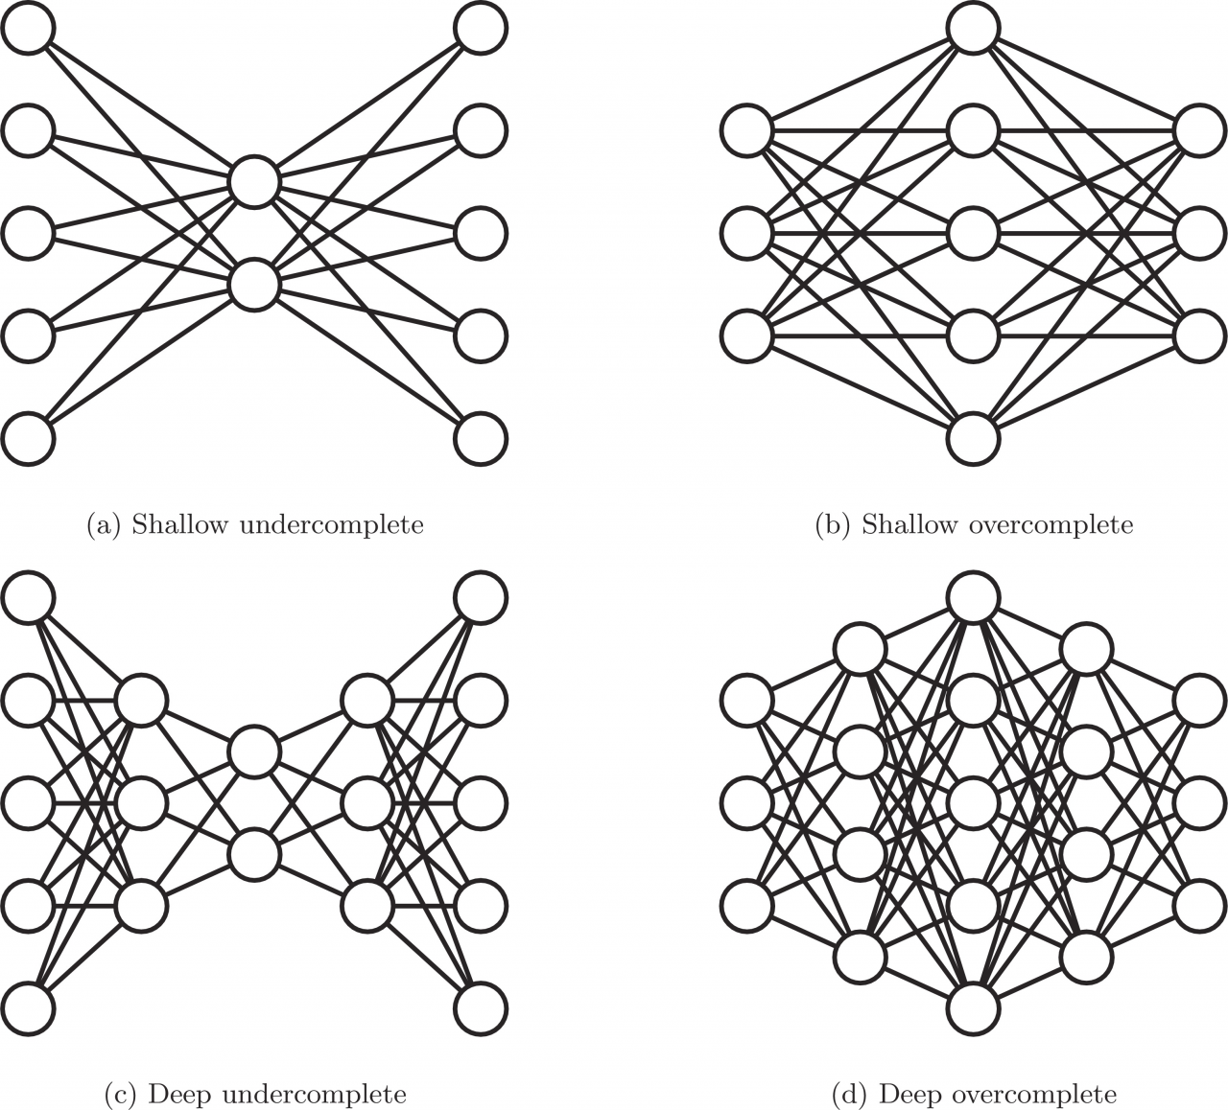
Undercomplete & Overcomplete Autoencoders

Slide 7
Undercomplete AEs:
This is when our encoding output's dimension is smaller than our input's dimension.
Essentially we reduce the dimension of our data (dimensionality reduction) with an
undercomplete AE
Each neuron in bottleneck layer carry important characteristic of the input.
Overcomplete AEs:
This is when our encoding output's dimension is larger than our input's dimension
Essentially we increase the dimension of our data with an overcomplete AE.
Fails to learn anything useful if the hidden layer(bottleneck layer) given too
much capacity. Simply copies the encoder input to the bottleneck layer.
Sometimes useful when we need more latent variable to represent our input.

Slide 8
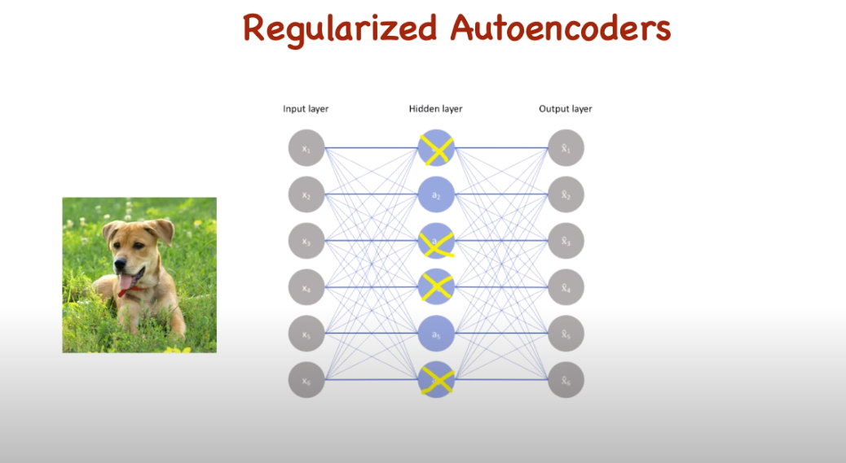
Regularized Autoencoders
Overcomplete autoencoders suffer from overfitting issue.
Regularized autoencoders use a loss function that encourages the model to have other properties besides the ability to copy its input to its output.
Two types:
Sparse Autoencoder
Denoising Autoencoder

Slide 9
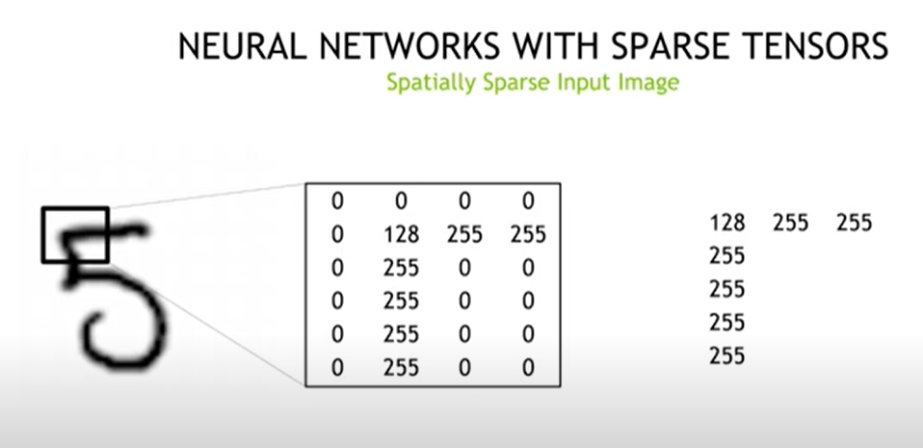
Sparse Autoenoder
Sparsity!
A sparse autoencoder is simply an autoencoder whose training criterion involves a sparsity penalty.
In usual process; we construct loss function by penalizing the weights, but here we penalize the activation of the hidden layers,so that only a few nodes are encouraged to activate when a single sample is fed into the network

Slide 10
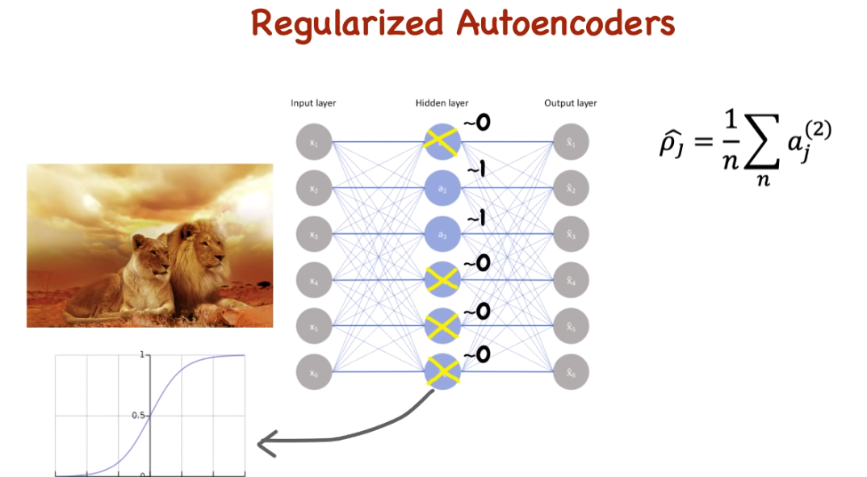
It is based on assumption that average of activation nearly equals 0.
Except for the first two terms, we add the third term which penalizes the absolute value of the vector of activations a in layer h for sample i. Then we use a hyperparameter to control its effect on the whole loss function. And in this way, we do build a sparse autoencoder.

Slide 11
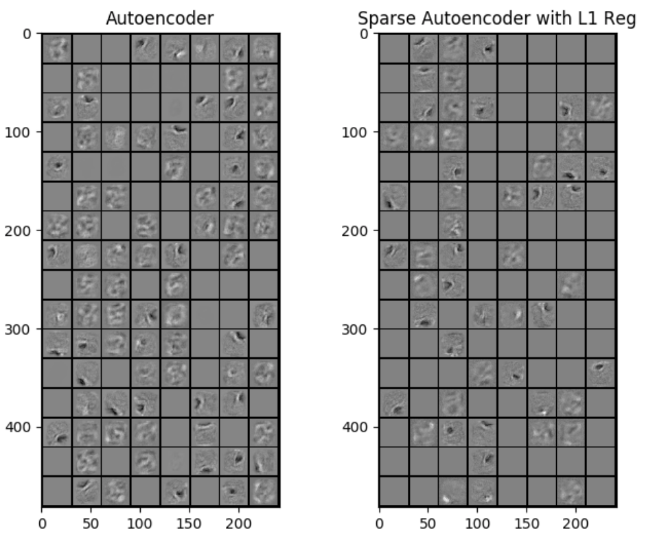

Slide 12
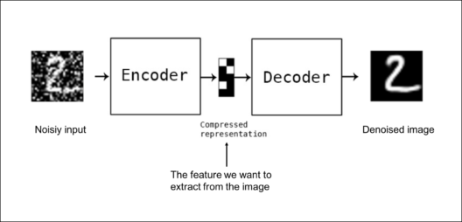
Denoising Autoencoder
Denoising: input image + noise and train to reproduce the input image at output.

Slide 13
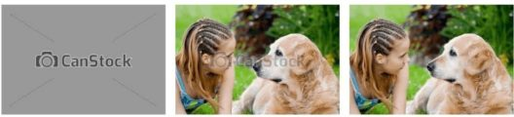
Real-life Denoising Autoencoder example

Slide 14
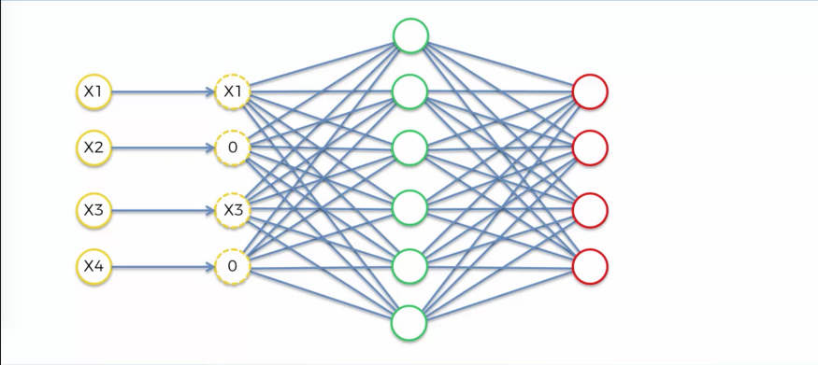
Denoising Autoencoders solve this problem by corrupting the data on purpose by randomly turning some of the input values to zero with a certain probability p.
Lets say for this example p=50% , so half of the inputs are set to zero.
But, once we construct the image on the decoder side, we compare it with original input image. Hence we compare the loss with respect to the original image.

Slide 15
Stochastic Encoders and Decoders
General strategy for designing the output units and loss function of a feedforward network is to
Define the output distribution p(y|x)
Minimize the negative log-likelihood –log p(y|x)
In this setting y is a vector of targets such as class labels
In an autoencoder x is the target as well as the input
Yet we can apply the same machinery as before, as we see next
15

Slide 16
Loss function for Stochastic Decoder
Given a hidden code h, we may think of the decoder as providing a conditional distribution p_{decoder}(x|h)
We train the autoencoder by minimizing –log p_{decoder}(x|h)
The exact form of this loss function will change depending on the form of p_{decoder}(x|h)
As with feedforward networks we use linear output units to parameterize the mean of the Gaussian distribution if x is real
In this case negative log-likelihood is the mean-squared error
With binary x correspond to a Bernoulli with parameters given by a sigmoid
Discrete x values correspond to a softmax
The output variables are treated as being conditionally independent given h

Slide 17
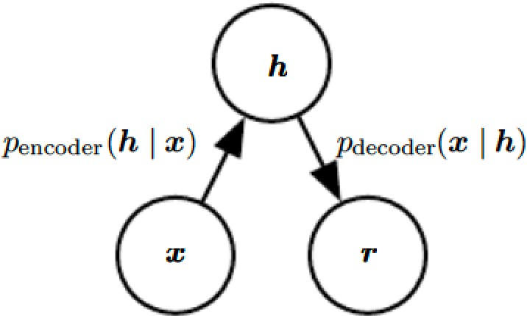
Stochastic encoder
We can also generalize the notion of an encoding function f(x)
to an encoding distribution p_{encoder}(h|x)

Slide 18
Structure of stochastic autoencoder
Both the encoder and decoder are not simple functions but involve a distribution
The output is sampled from a distribution p_{encoder}(h|x) for the encoder and p_{decoder}(x|h) for the decoder

Slide 19
Properties of Autoencoders
Data-specific: Autoencoders are only able to compress data similar to what they have been trained on.
Lossy: The decompressed outputs will be degraded compared to the original inputs.
Learned automatically from examples: It is easy to train specialized instances of the algorithm that will perform well on a specific type of input.

Slide 20
Applications
Autoencoders are used largely for anomaly detection: As we know, autoencoders create encodings that basically captures the relationship among data. Now, if we train our autoencoder on a particular dataset, the encoder and decoder parameters will be trained to represent the relationships on the datasets the best way. Thus, will be able to recreate any data given from that kind of dataset in the best way. So, if data from that particular dataset is sent through the autoencoder, the reconstruction error is less. But if some other kind of data is sent through the autoencoder it will generate a huge reconstruction error. If we are able to apply a correct cutoff we will be able to create an anomaly detector.
Autoencoders are used for Noise Removal: If we can pass the noisy data as input and clean data as output and train an autoencoder on such given data pairs, trained Autoencoders can be highly useful for noise removal. This is because noise points usually do not have any correlations. Now, as the autoencoders need to represent the data in the lowest dimensions, the encodings usually have only the important relations there exists, rejecting the random ones. So, the decoded data coming out as output of an autoencoder is free of all the extra relations and hence the noise.
Autoencoders as Generative models: Before the GAN’s came into existence, Autoencoders were used as generative models.
Autoencoders used for collaborative filtering: Collaborative filtering normally uses matrix factorization methods, but autoencoders can learn the dependencies and learn to predict the item-user matrix

